Slide 1
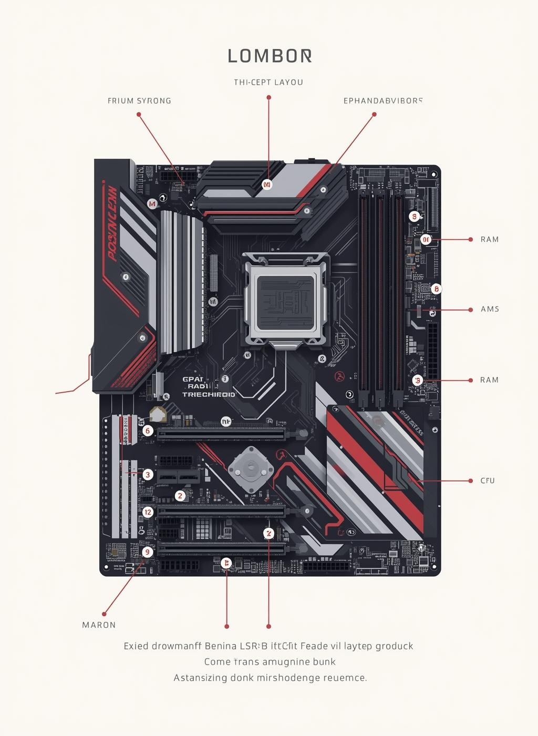

Computer Basics
Motherboard and Ports
Hana

Slide 2
motherboard

Slide 3


Agenda
Introduction to Motherboard
Components on the Motherboard
Expansion Slots
Hana
Ports

Slide 4
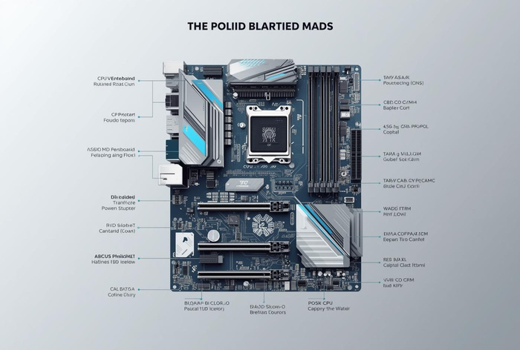

Introduction to Motherboard
Definition
The motherboard is the main circuit board connecting all computer components.
Role
It enables communication and power distribution among all parts of a computer system.

Slide 5
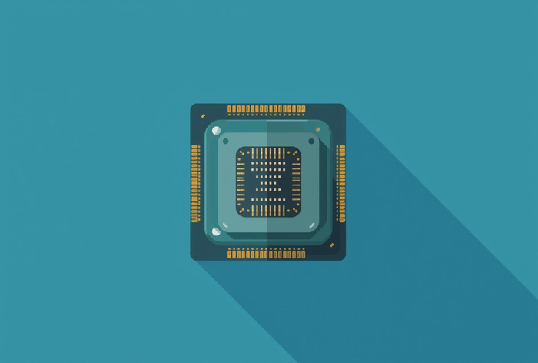
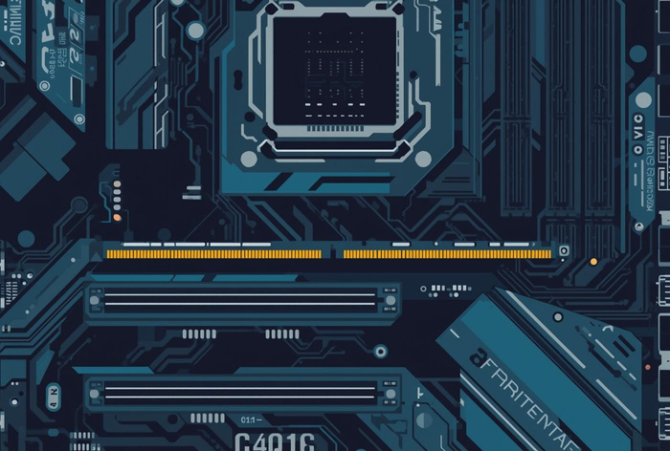
Motherboard Components
CPU Socket
Slot connecting the processor to memory and other parts.
RAM Slots
Hold memory modules for temporary data storage.

Slide 6
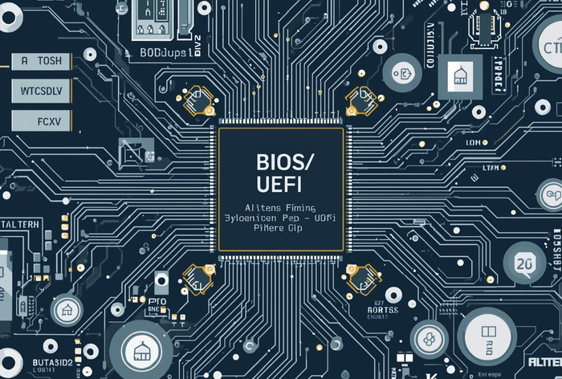
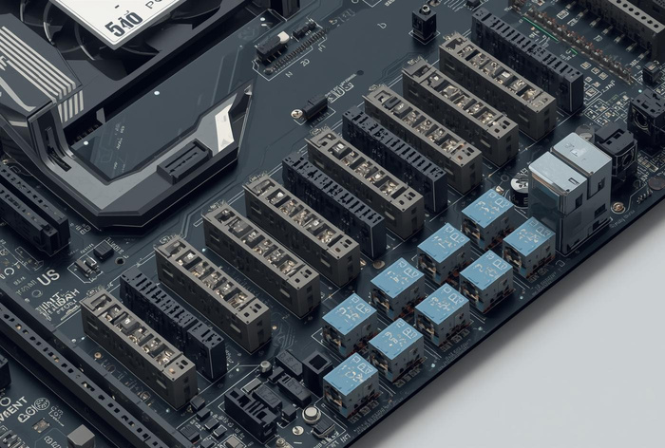
Motherboard Components
BIOS/UEFI
The BIOS/UEFI chip stores firmware for system startup and hardware initialization.
Power Connectors
Power connectors supply electricity from the power supply unit to the motherboard.

Slide 7
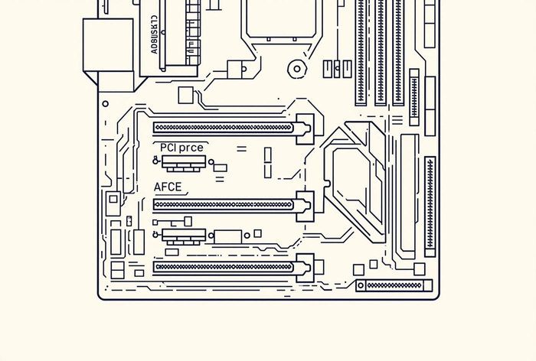
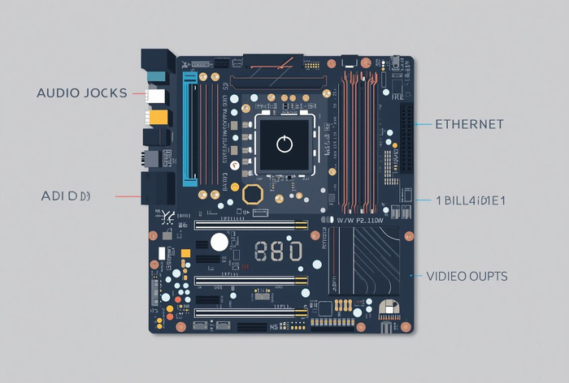
Motherboard Components
Expansion Slots
Expansion slots allow users to add extra cards for enhanced functionality.
Integrated Components
Integrated components include built-in features like audio and Ethernet ports.

Slide 8
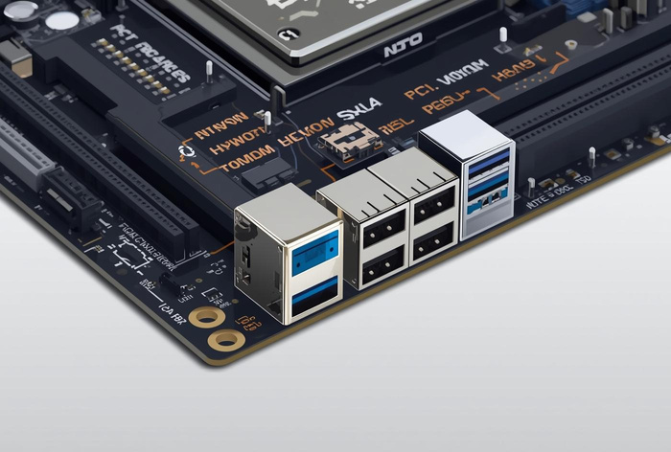
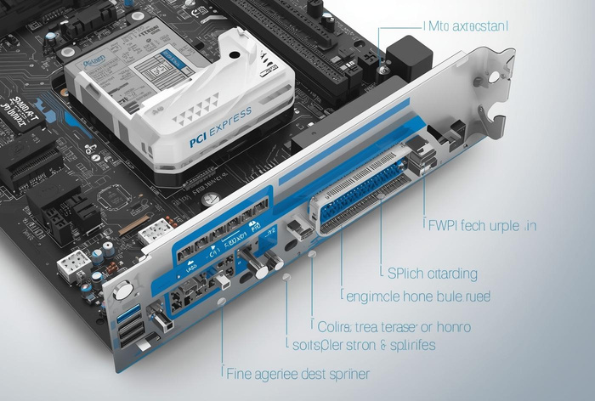
Expansion Slots Overview
PCI Slots
Older slots for adding sound, network, and USB expansion cards.
PCI Express (PCIe)
Modern high-speed slots primarily for graphics cards and SSDs.

Slide 9
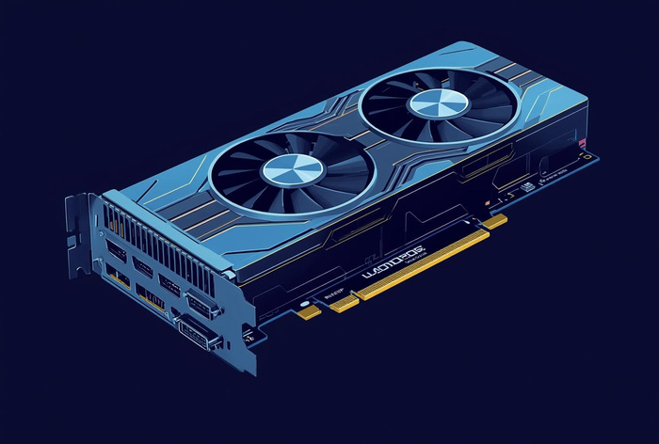
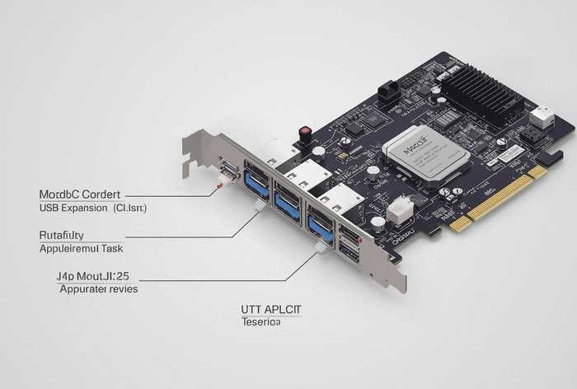
Expansion Slots: Typical Uses
Upgrading Graphics
Expansion slots allow for enhanced graphics through powerful graphics card upgrades.
Adding Ports
Additional expansion slots enable the connection of more ports for devices.

Slide 10
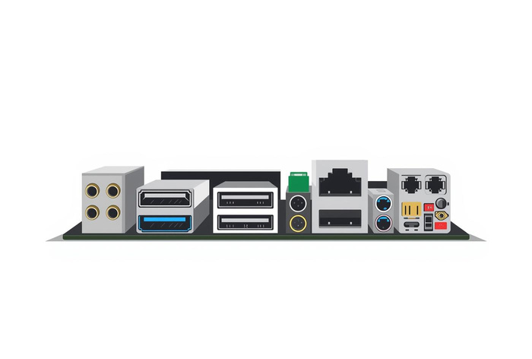
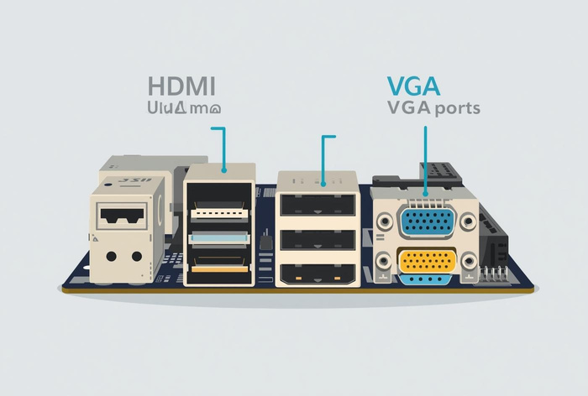
Common Ports on Motherboards
USB Ports
USB ports connect various peripherals like keyboards and mice for data transfer and power.
HDMI and VGA
HDMI and VGA ports are used for connecting monitors and projectors, enabling video output.

Slide 11
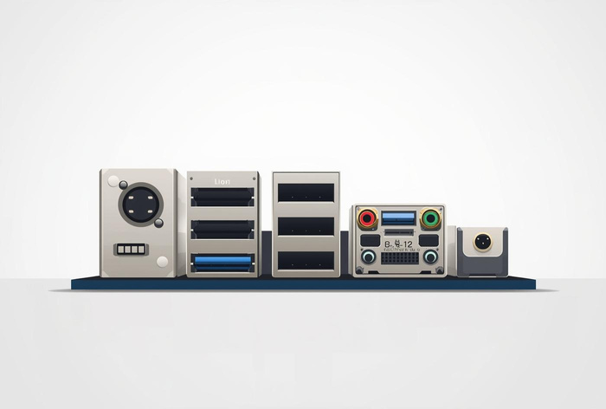
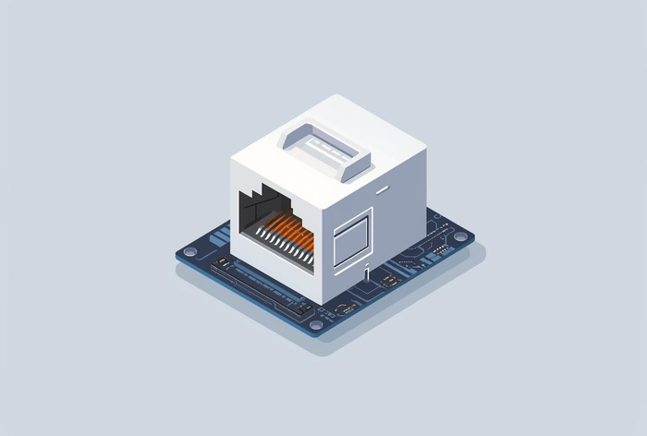
Common Audio and Network Ports
Audio Ports
3.5mm audio jacks are used for connecting headphones, microphones, and speakers.
Ethernet Port
The Ethernet port provides a wired connection for networking and internet access.

Slide 12
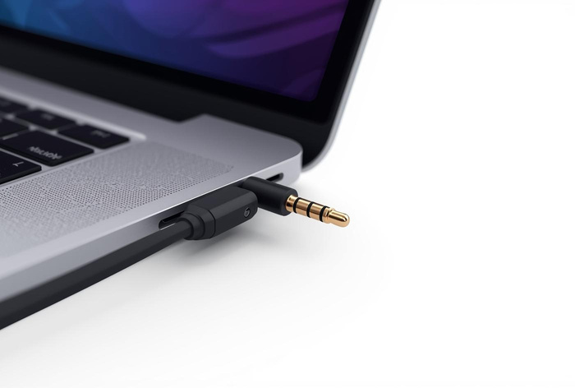
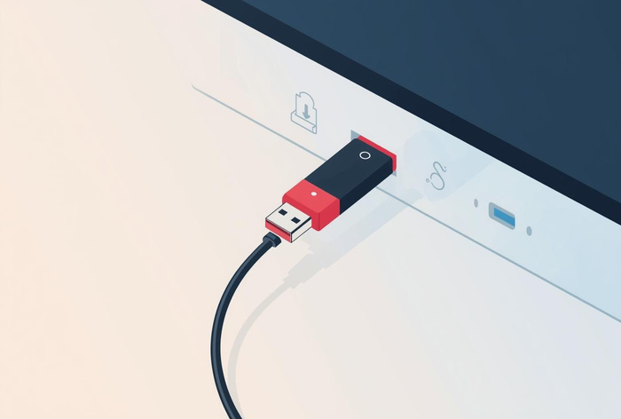
Examples of Device Connections
Headphones
Headphones connect via 3.5mm audio ports for sound output.
USB Drive
USB drives connect through USB ports for data transfer and storage.

Slide 13
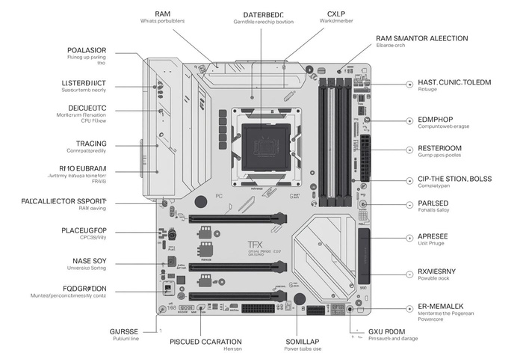
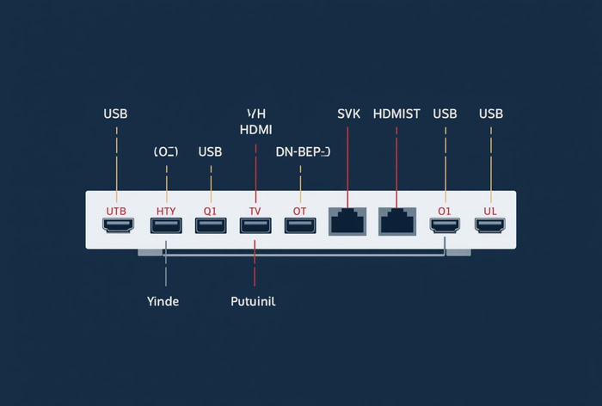
Importance of Motherboards
Central Role
Motherboards connect all computer components, enabling smooth communication and power distribution.
Connectivity
Ports allow devices to connect, facilitating data transfer, power supply, and communication.

Slide 14
Thank you!

